Slide 1
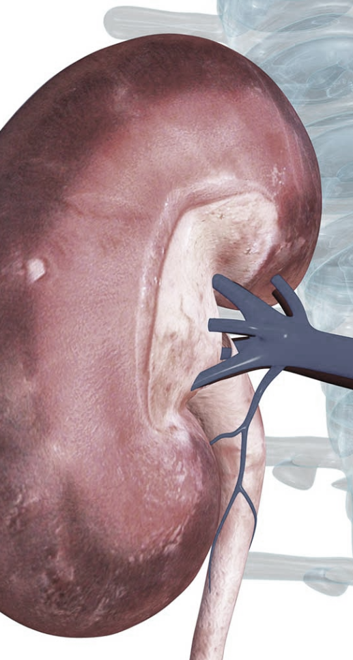
A REPRODUCIBLE, AUTOMATICALLY UPDATABLE, CURATED AND PUBLICLY AVAILABLE LIST OF ALL RELEVANT KIDNEY ASSOCIATED GENES
KIDNEY - GENETICS
2023-07-05 AG Halbritter

Slide 2
Kidney-Genetics
Status quo
CURATED GENE LIST
Aim
Design a reproducible, automatically updatable, curated and publicly available list of all relevant kidney associated genes
Current status
Coding of different evidence pillars
Manual curation of high evident genes
Building an easy to use web interface
Perspective
Evidence scorecard and Curation
Automatic regular PubTator query
Automated PanelApp request
Literature request for Kidney Panels
Clinical diagnostic panel data
HPO based search in OMIM/Orpha.
ClinGen curated gene lists

Slide 3
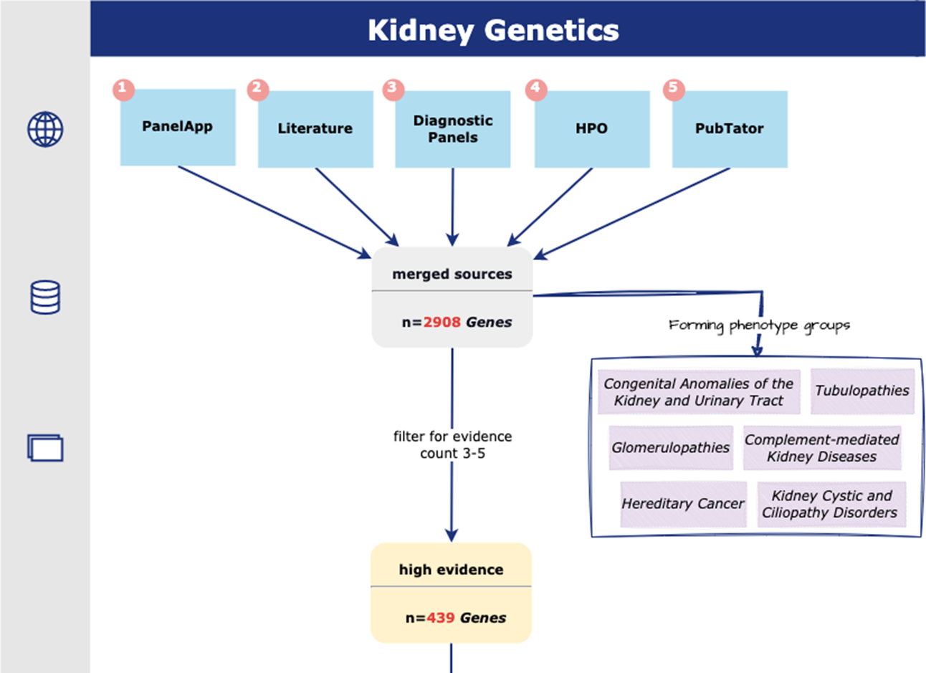
Kidney-Genetics
Status quo
Flowchart:

Slide 4
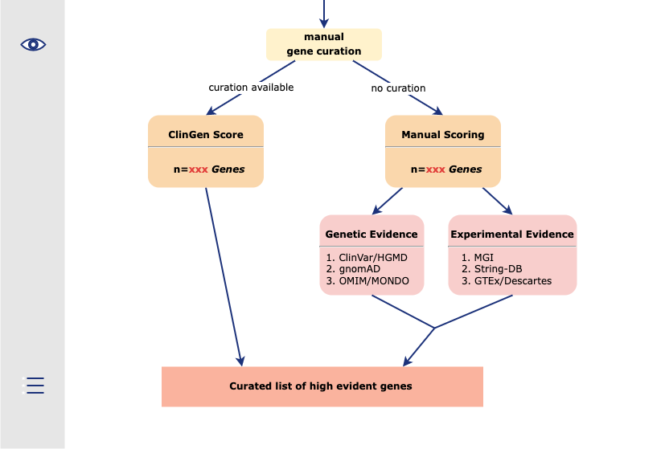
Kidney-Genetics
Status quo
Flowchart:

Slide 5

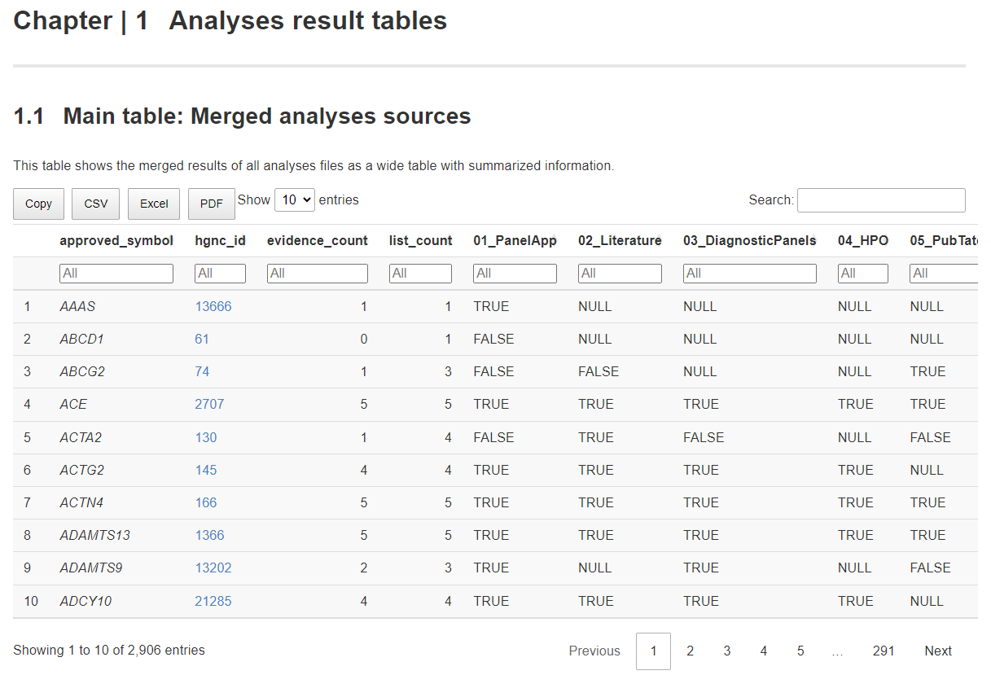
Kidney-Genetics
Status quo
Current status
Publicly accessible GitHub page with all code
https://github.com/halbritter-lab/kidney-genetics
We document all steps there to make it as reproducible as possible
Annotation of Genes
https://halbritter-lab.github.io/kidney-genetics/

Slide 6
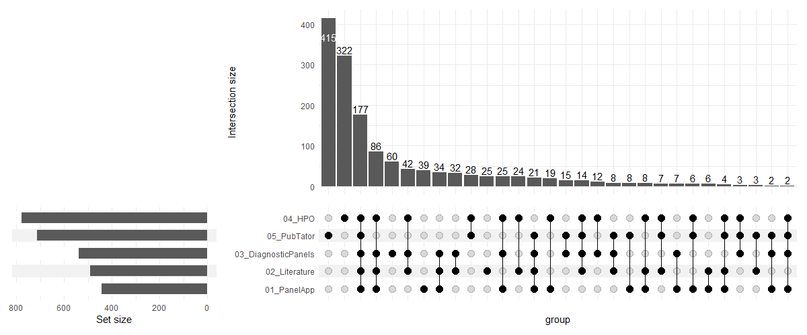
Kidney-Genetics
Status quo
UpSet plot of merged analyses sources
Current status
Automated separation of the merged genes into different categories: -phenotype -onset (adult/young) -syndromic/non-syndromic
https://halbritter-lab.github.io/kidney-genetics/analyses-plots.html#upset-plot-of-merged-analyses-sources

Slide 7
Any more questions?

